Slide 1




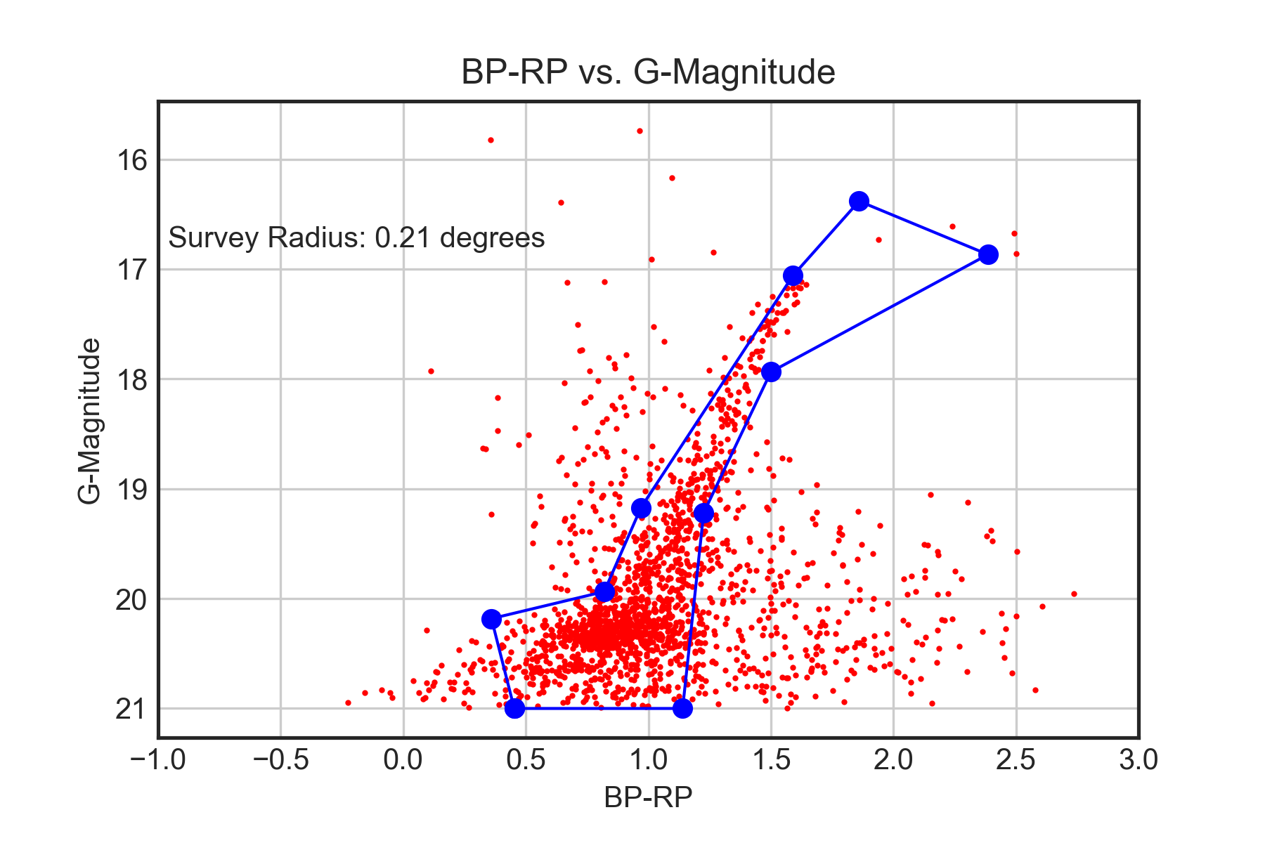
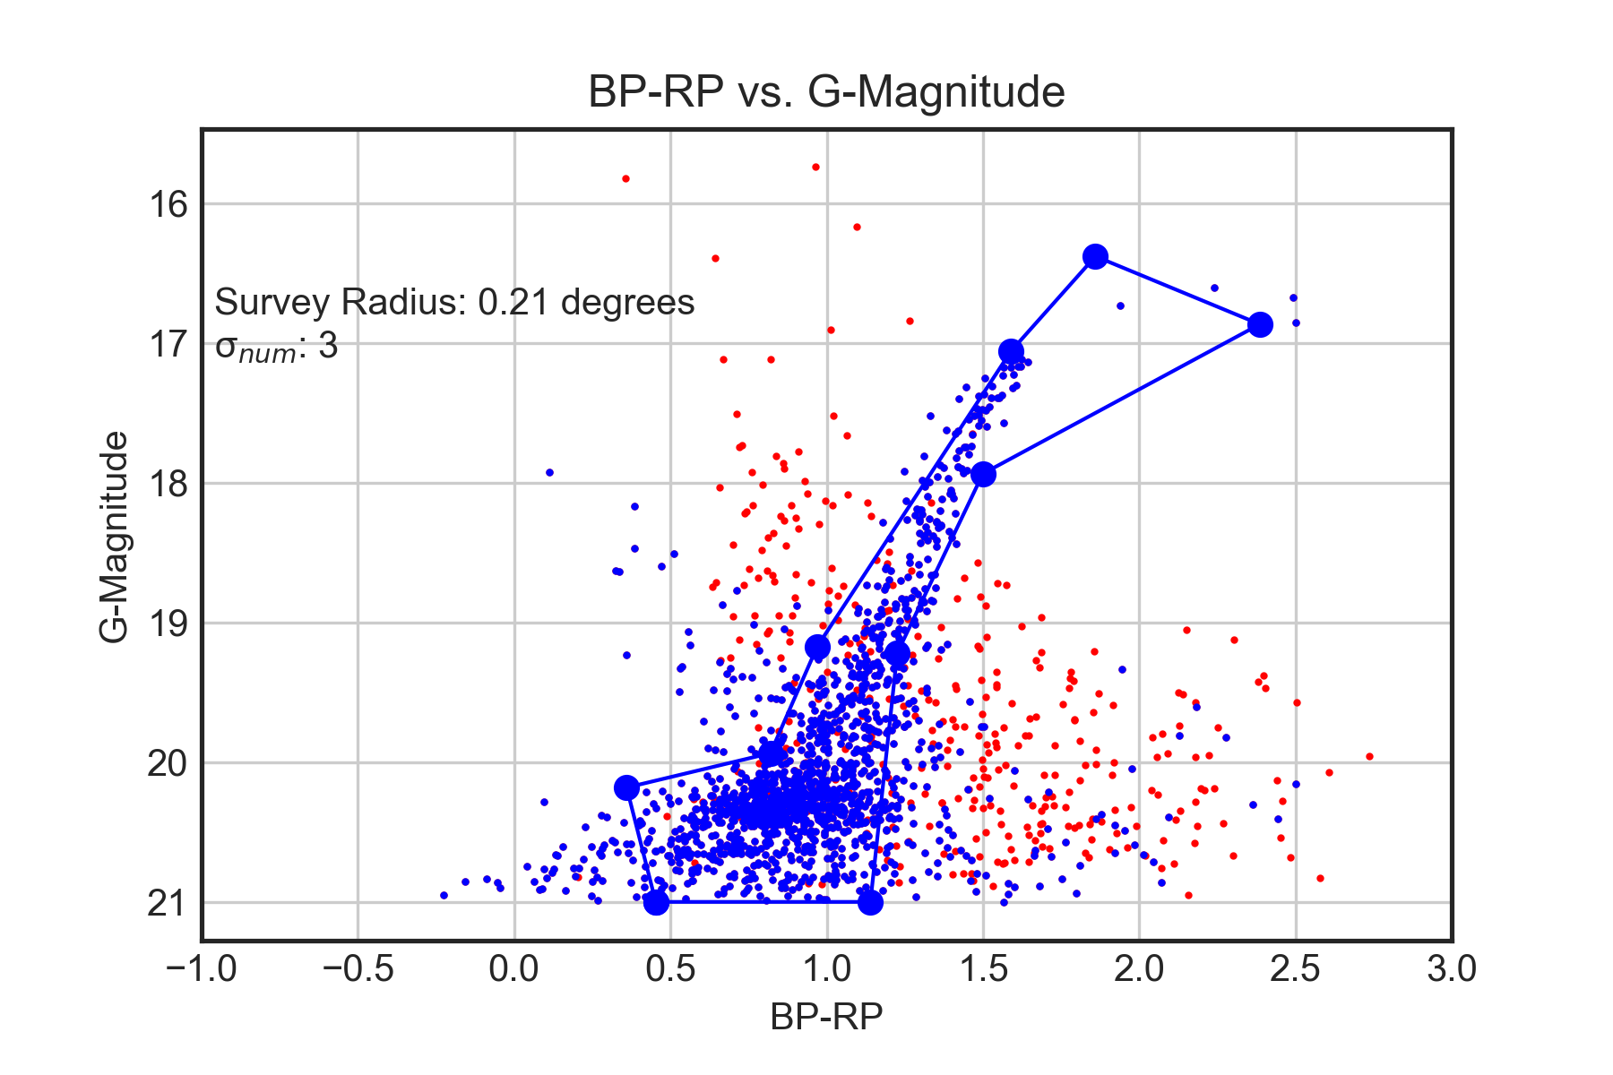
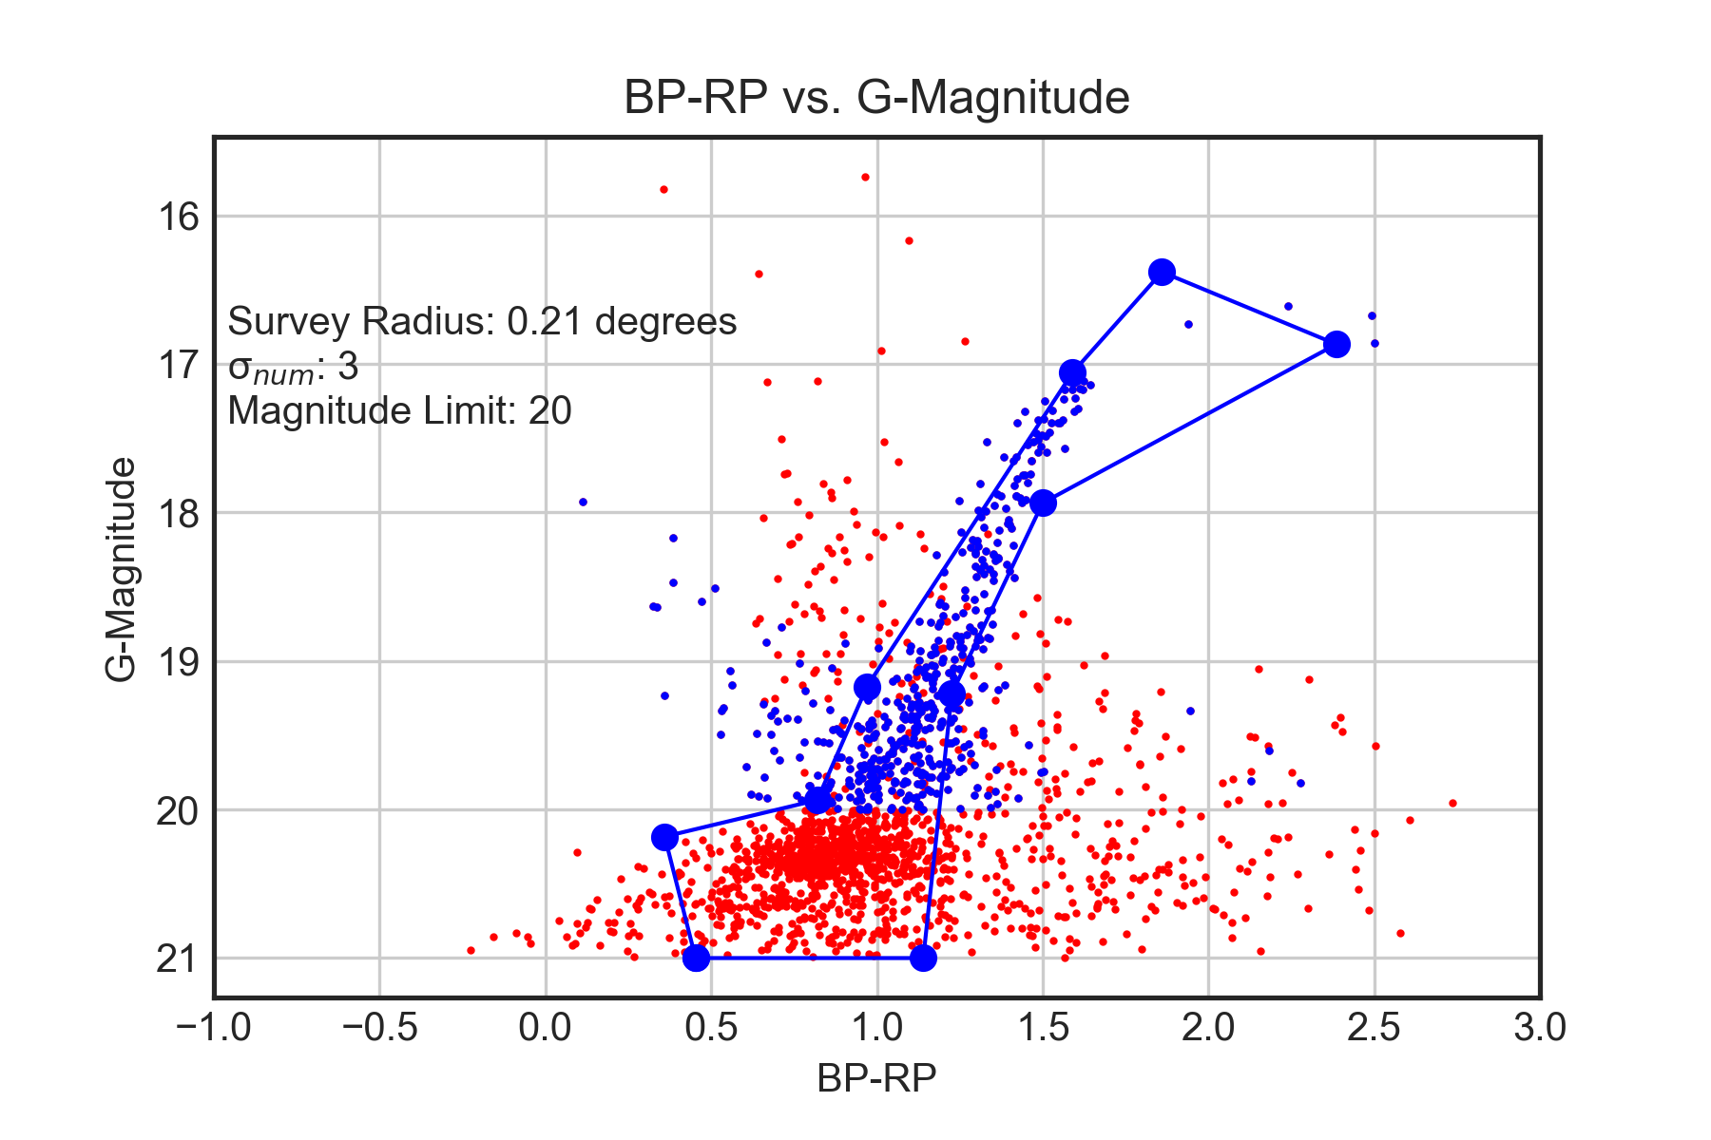
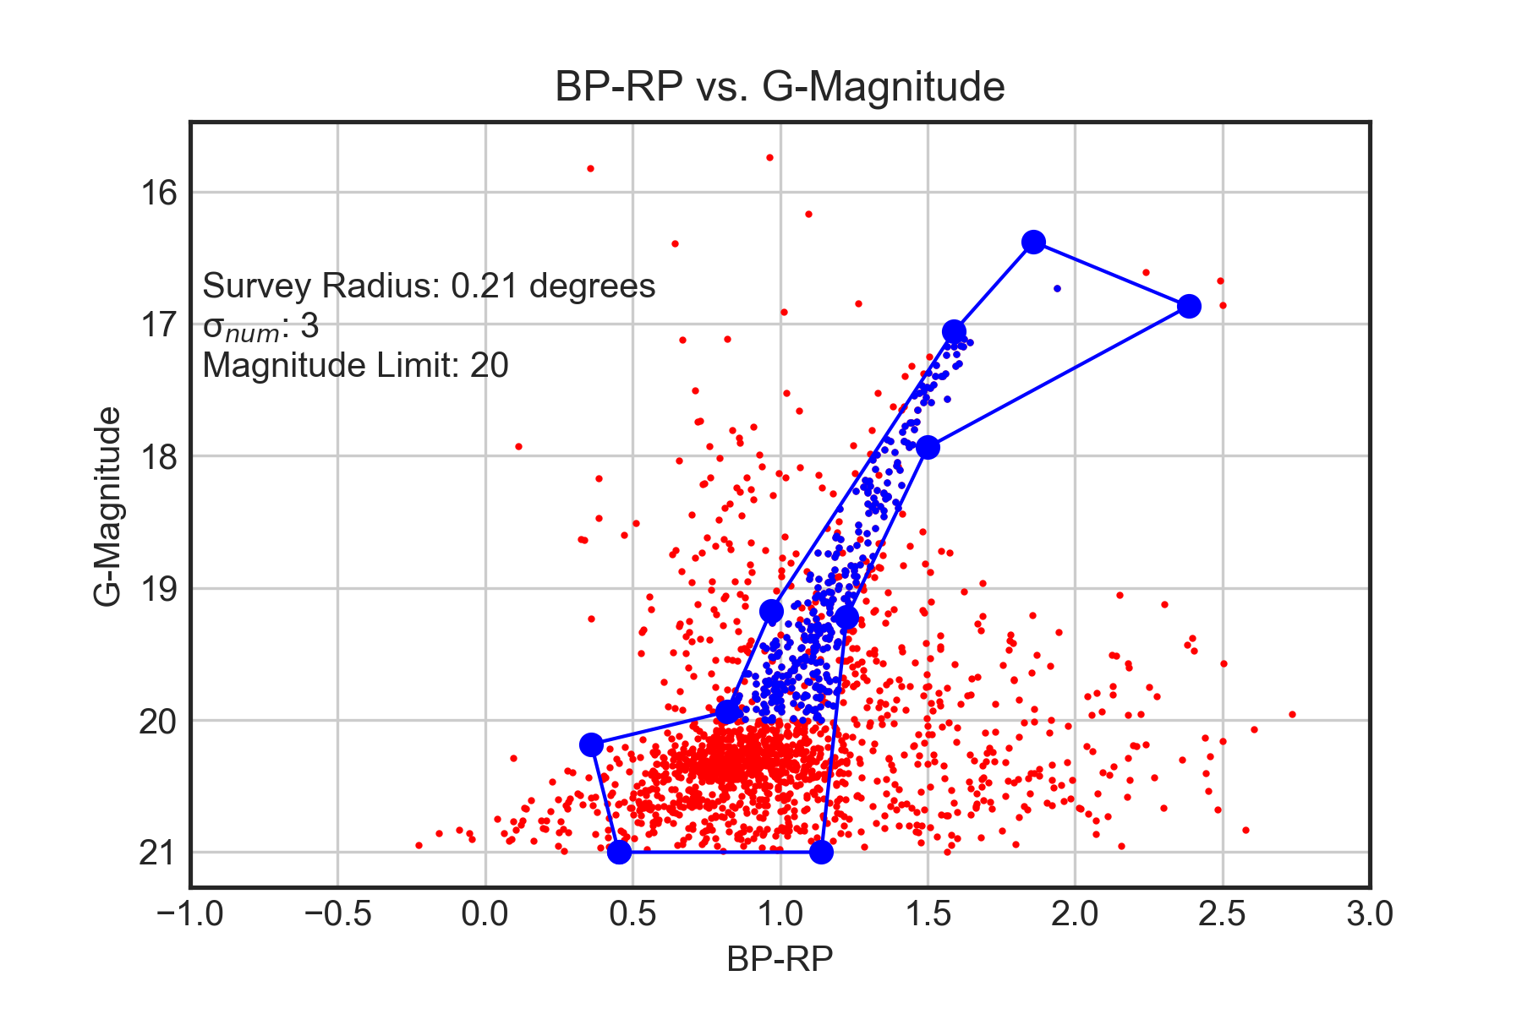
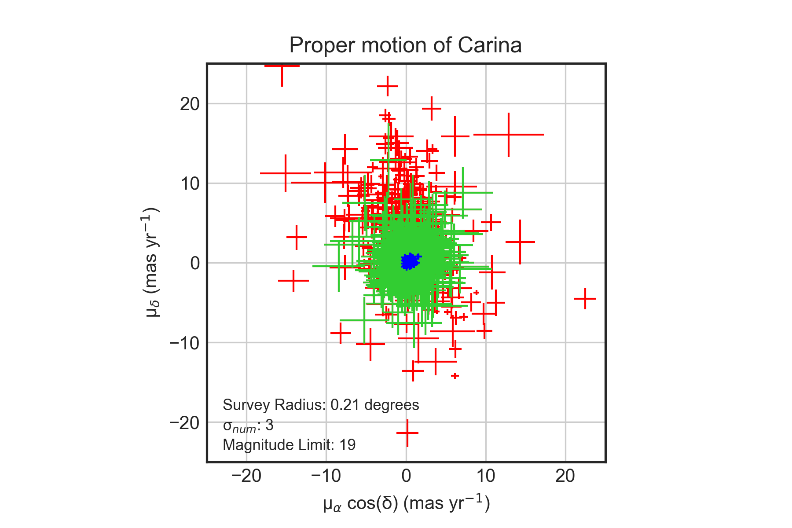
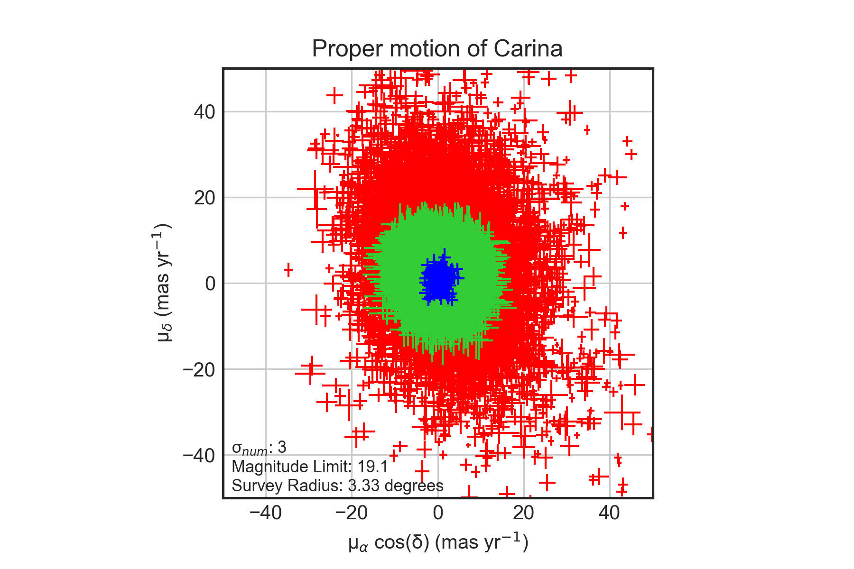
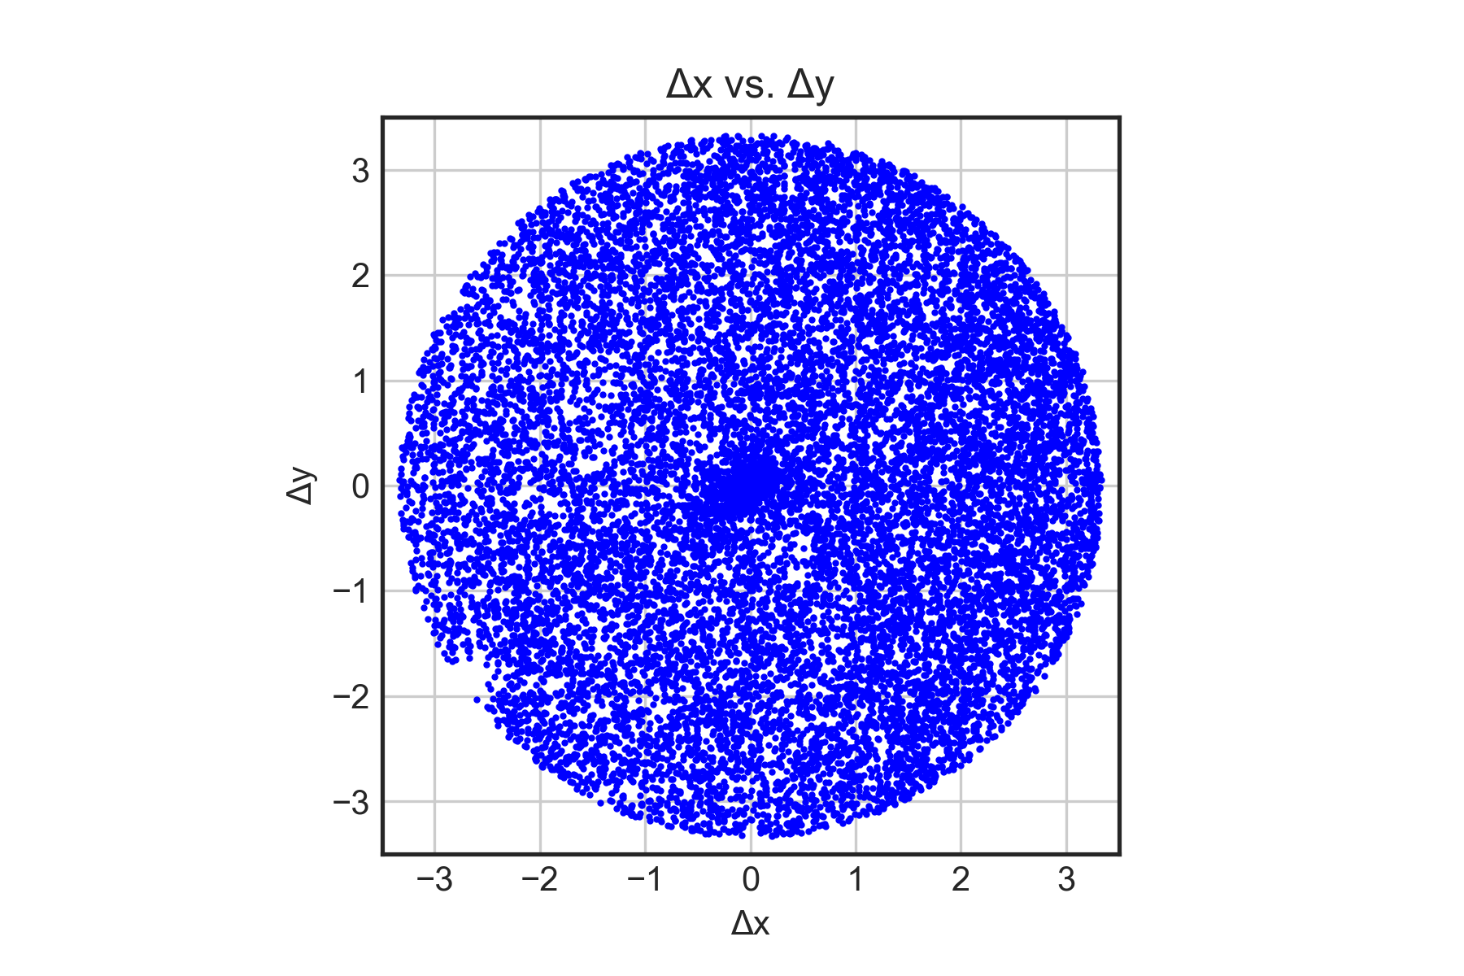
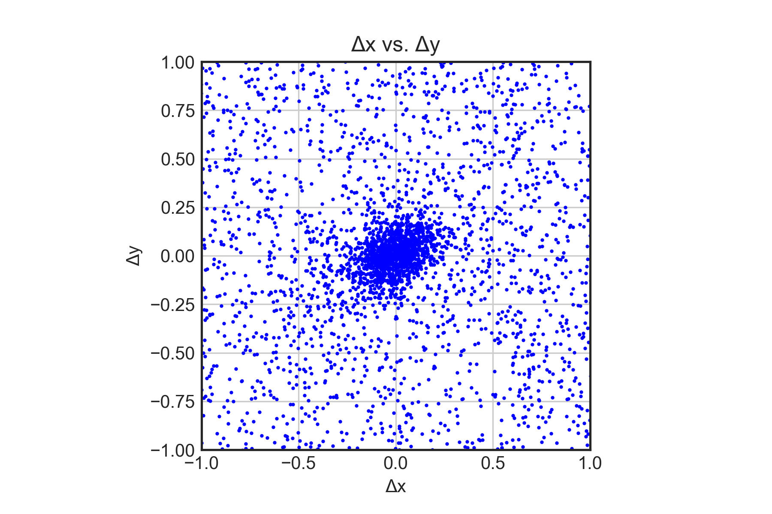
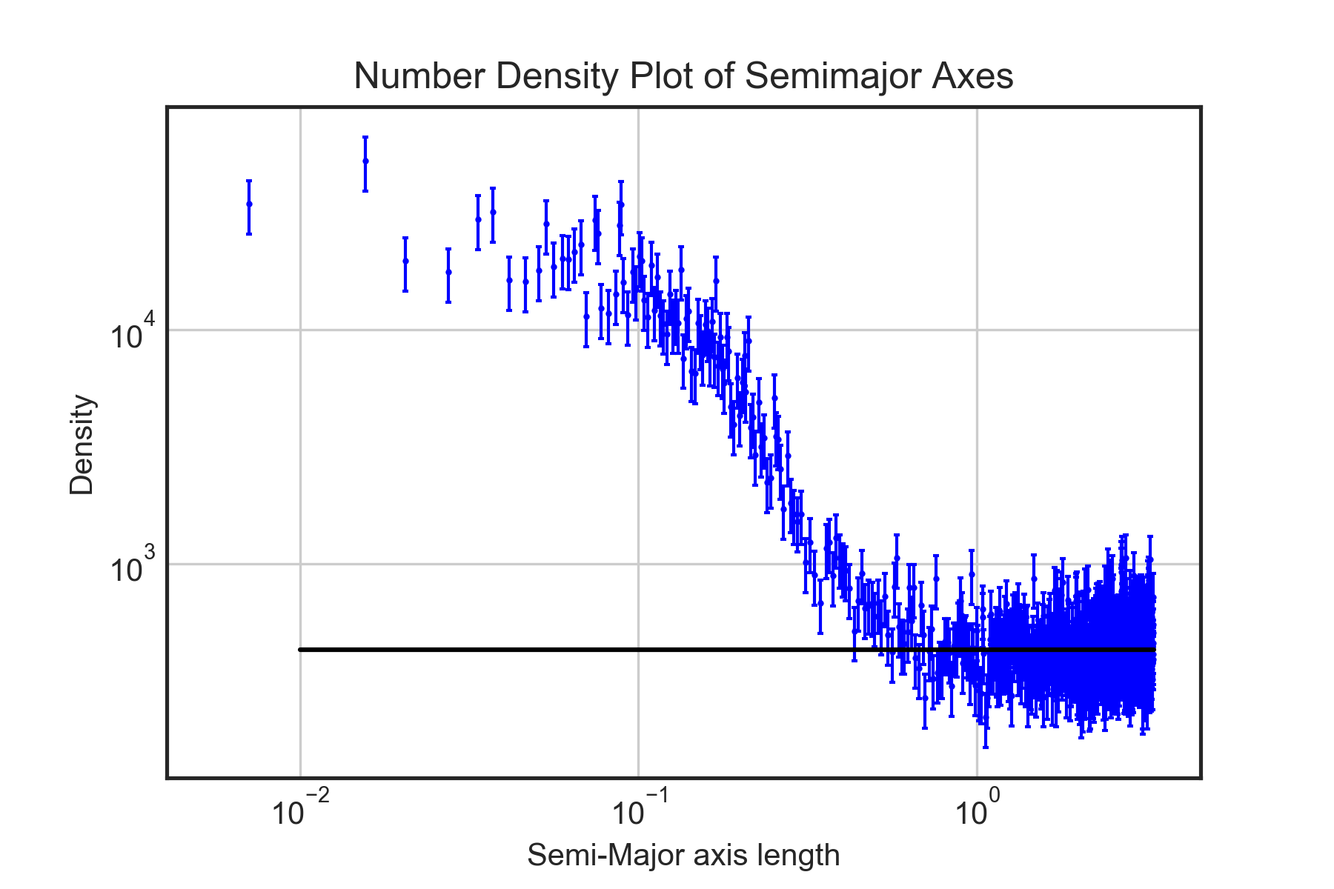
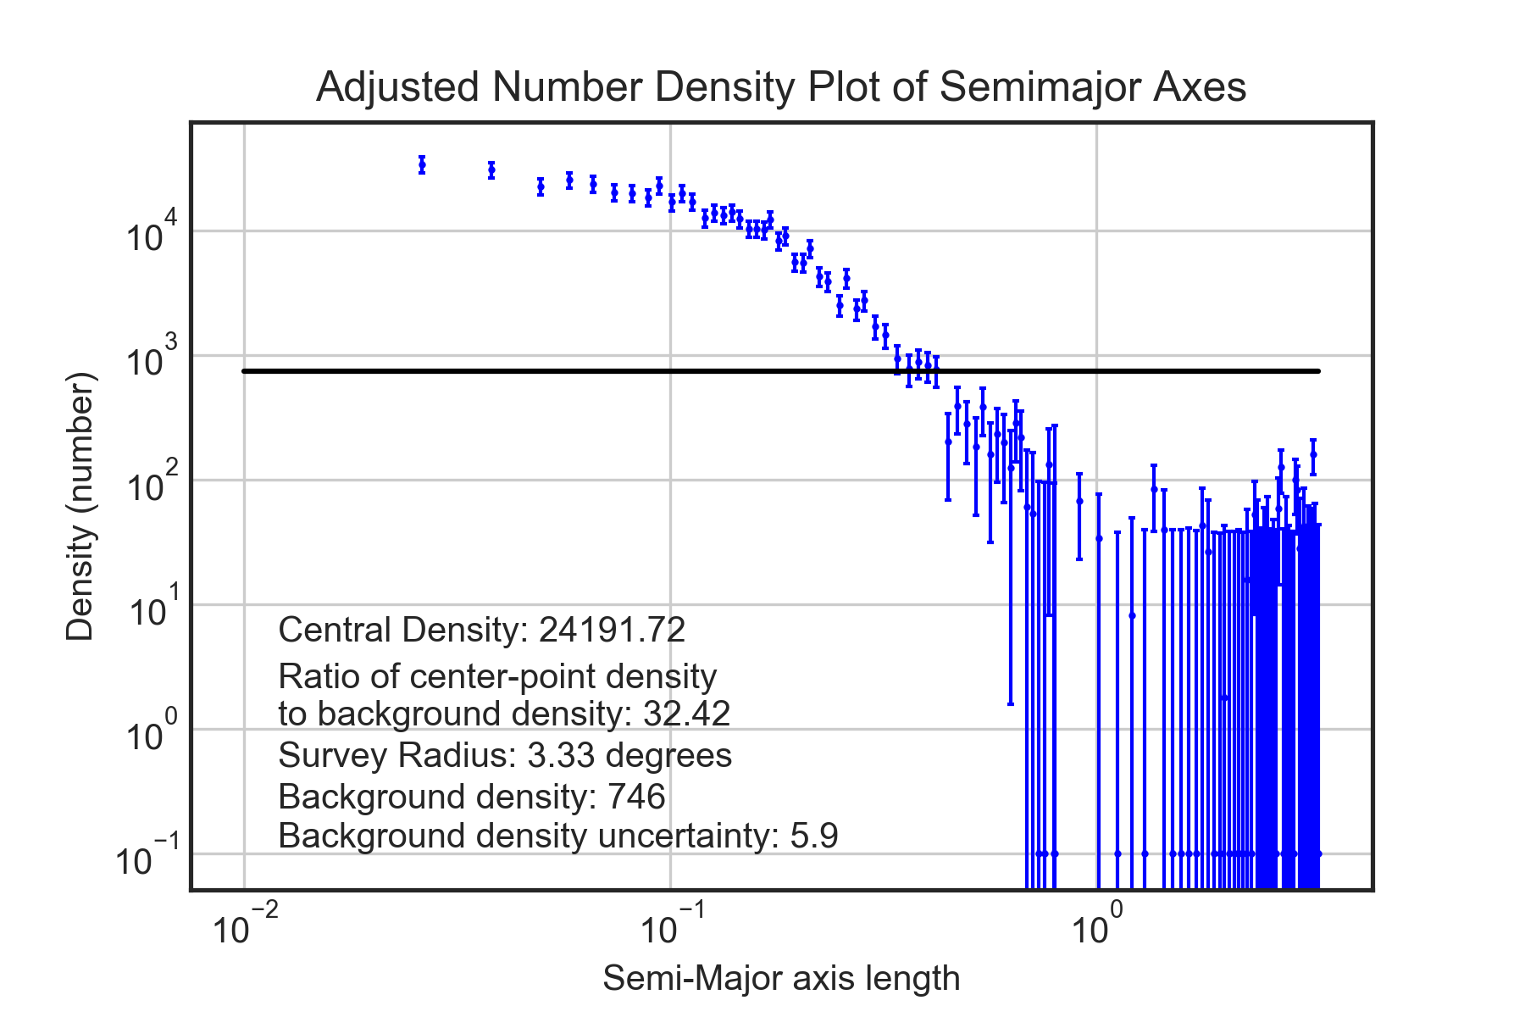
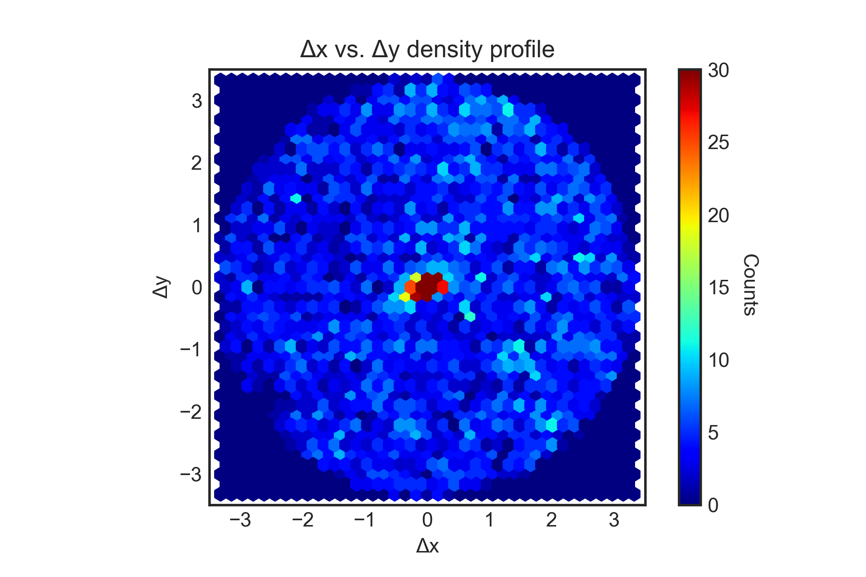
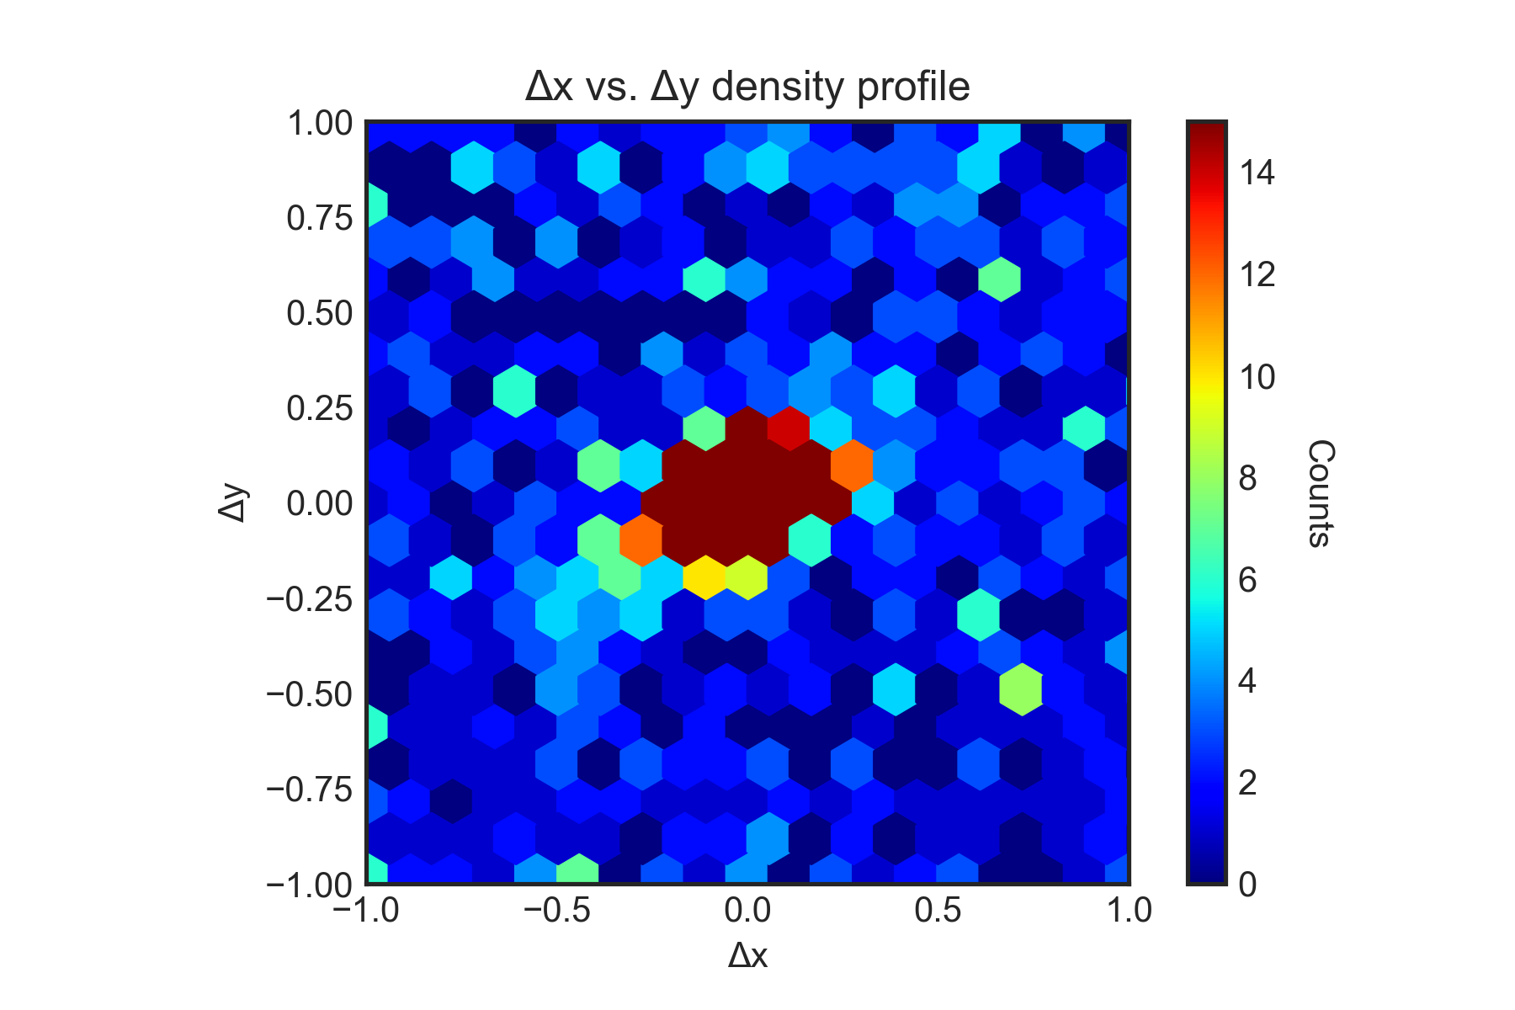
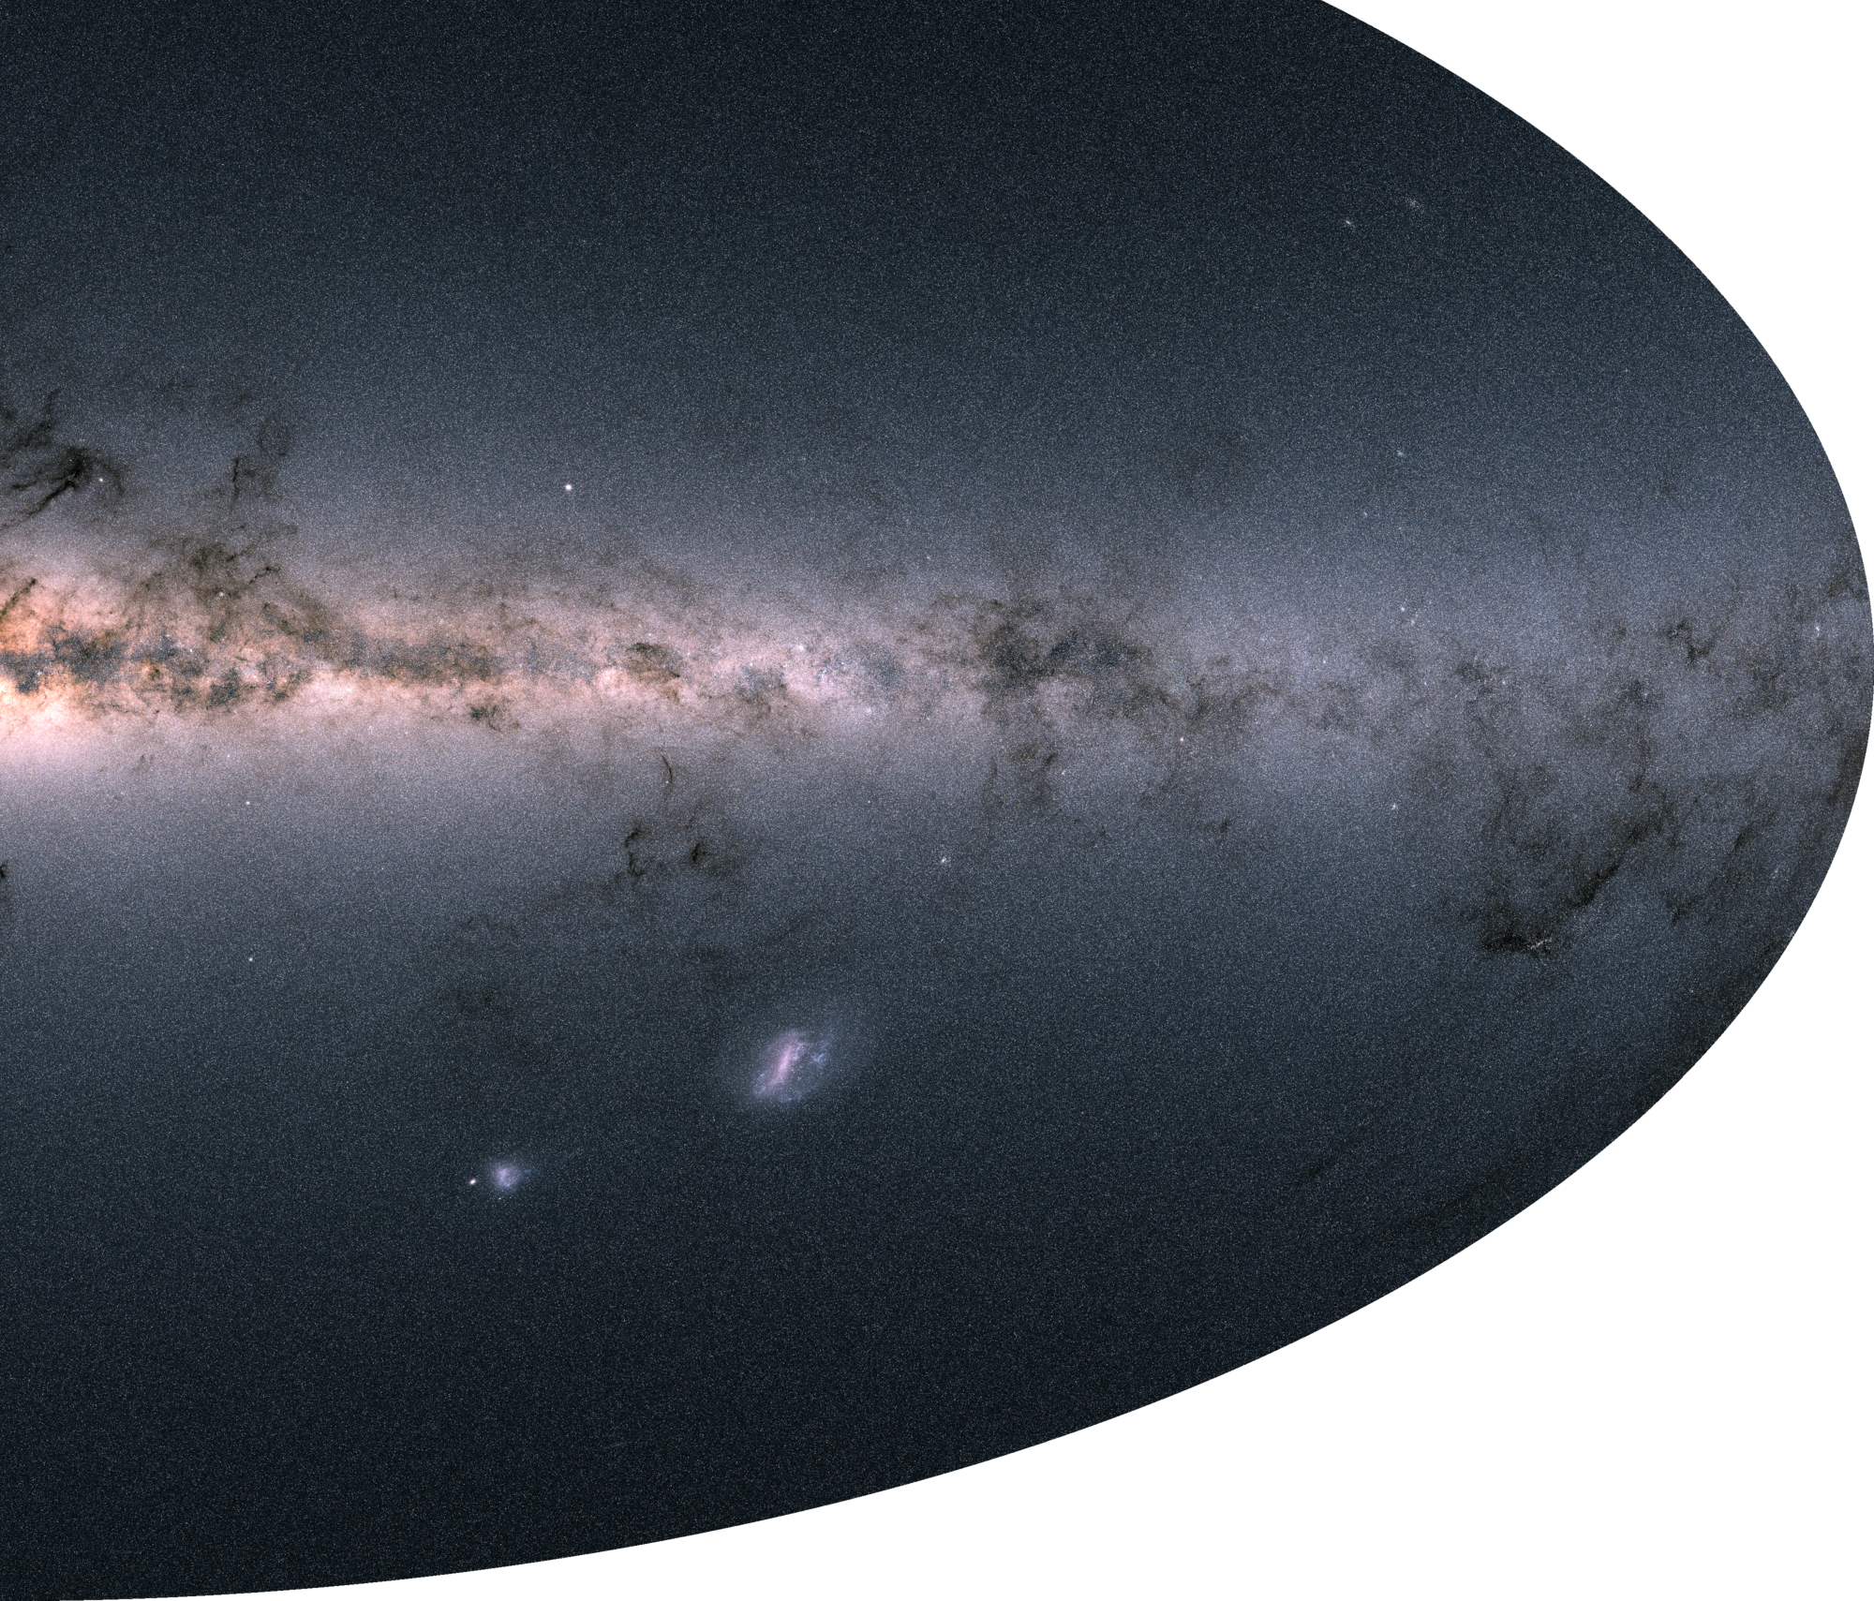
A Search for Tidal Tails in Carina
Sean MacBride¹, Carlton Pryor²
¹ Wheaton College Massachusetts, ² Rutgers University
Abstract
Methods
We searched for evidence of tidal stripping in the spatial structure of the dwarf satellite galaxy Carina using data from the European Space Agency satellite Gaia. The satellites of our Milky Way Galaxy are remnants of and clues to its birth. Carina is intriguing because it has a more extended star formation history than other dwarf satellite galaxies of similar mass. In larger satellite galaxies the gas is retained longer, and this allows star formation to continue. The star formation history of Carina suggests that it was once more massive, and has been truncated by the gravitational forces of the Milky Way or some other satellite. Gaia surveyed the entire sky to provide precise photometry, proper motions, parallaxes, and positions for over one billion stars. The proper motion and parallax data are especially intriguing, as measurements of such precision were not previously available for most of the stars. We selected potential members of Carina based on proper motion and position in the color-magnitude diagram over an area of the sky ~6.5 degrees across, and used these stars to search for low-surface-density indications of tidal interaction, such as non-axisymmetric distortions of the outer regions of Carina or extended tails along the direction of orbital motion that would indicate tidally-removed stars.
Stars in our sample were selected using position, photometric location, and proper motion. 1) A sample containing the central parts of the galaxy determined the bounds in the color-magnitude diagram (CMD).
2) Stars in the sample were required to have their proper motion agree with the mean value for the galaxy from Gaia Collaboration (2018b) within a fixed multiple (3, in this case) of the uncertainty.
3) Imposing a magnitude limit can be useful for restricting the sample to brighter stars with more accurate proper motions.
4) Measuring radial surface density profiles required imposing an elliptical outer boundary of the location of the stars in the sample, whose shape matched that of Carina (see fig. 8 and 9).
Fig. 2 – Selected region in the CMD
Fig. 3 – Member stars selected by proper motion in blue
Fig. 4 – Member stars selected by proper motion and magnitude in blue
Fig. 5 – The final sample of member stars in blue
Results
Proper Motion Accuracy vs. Magnitude
Tangent Plane Projection
Background
Gaia is a European Space Agency satellite that was launched in 2013 on a ten-year mission to measure unprecedentedly accurate data for over a billion stars across the entire sky. The most recent (second) major data release, DR-2, makes available photometry, positions, parallax, and proper motion for 1.3 billion stars (Gaia Collaboration, 2018b). The proper motion and photometric data were the most important in our search for tidal tails in Carina, as it allowed us to limit our sample to likely member stars.
Carina is a dwarf satellite galaxy. Satellite galaxies are remnants of the formation of the Milky Way orbiting in the Galactic halo. Carina lies at low galactic latitude (-22.2°, McConnachie 2012), so samples in its direction are contaminated with field stars. To combat this, we select likely member stars using photometry, proper motion, and parallax.
Analysis of deep photometry has shown that Carina has both old and intermediate-age stellar populations (Mould & Aaronson 1983; Santana et al. 2016). This extended star formation history indicates that Carina was once more massive than at present. One possible explanation for this is that a large number of Carina stars were tidally stripped from the galaxy by an interaction with another massive object (Santana et al. 2016). We are looking for large- and small-scale structures around Carina that would indicate that it has suffered such a tidal interaction.
Fig. 6 and 7 – Proper motions for stars within 0.21° and 3.33° respectively. In red: all stars. In green, all stars that are within the proper motion selection but not the magnitude limit. In blue: all stars that are within the proper motion selection and the magnitude limit
Fig. 8 – Tangent plane projection for a survey of 3.33 degrees, after full data processing
Fig. 9 – Tangent plane projection of final sample for central 1° x 1°
Surface Density Profiles
High Contrast Surface Density Plots
Fig. 10 – Surface density vs. semi-major axis length, not background subtracted
Fig. 11 – Surface density vs. semi-major axis length, background subtracted
Fig. 12 – Hexbin high-contrast surface density plots of the tangent plane projection
Fig. 13 – Hexbin high-contrast surface density plots of the tangent plane projection for central 1° x 1°
Conclusions
References
A restriction to brighter stars gives a better rejection of non-member stars but contains only a small fraction of all of the stars in the galaxy. This is evident in figures 6 and 7. Due to the large survey radius, figures 8-13 use the location of stars in a tangent plane projection. This projection avoids the distortions inherent with spherical coordinates. The direction of the orbital motion of Carina on the sky is 27.0° ± 2.3° north of east. The location of stars within 3.33° of the center, shown in figure 8, shows no obvious tidal tails with this, or any other, orientation. This absence is confirmed by figure 12, which shows a hexbin image of the surface density with the contrast-enhanced around the background value. Figure 13, which is a similar image of the surface density of the central 1° x 1°, shows densities are higher about 0.5° to the southwest of Carina than 0.5° to the northeast.
Future work with Carina would include a closer investigation of the small-scale (0.5°) structure, including whether it can be explained as a tidal feature of Carina. Future Gaia data releases will include more data, and as a result be much more accurate. This will allow for better rejection of non-members and so allow a search for fainter structures at larger radii.
Gaia Collaboration, Brown, A.G.A., Vallenari, A., et al. 2018a, A&A, in press (arXiv:1804.09365)
Gaia Collaboration, Helmi, A., van Leeuwen, F., et al. 2018b, A&A, in press (arXiv:1804.09381)
Muñoz, R. R., Majewski, S. R., Zaggia, S., et al. 2006, ApJ, 649, 201
McConnachie A. W., 2012, AJ, 144, 4
Santana, F. A., et al. 2016, ApJ, 829, 86
Mould, J., & Aaronson, M. 1983, ApJ, 273, 530
This project has been supported by funding from National Science Foundation grant PHY-1560077.
The location of Carina in a half-sky image, where brightness indicates the total amount of light measured by the Gaia satellite.
Notes:
Font Sizes: 84, 56, 42, 32

